Slide 1
Chapter 3. Techniques of Circuit Analysis

Slide 2
Contents
3.1 Basic concepts
3.2 2b-method for Circuit Analysis
3.3 Node-Voltage Analysis Method
3.4 Mesh-Current Analysis Method
3.5 Thévenin and Norton Theorem
3.6 Maximum Power Transfer Theorem

Slide 3
3.1 Basic concepts

Slide 4
Before the study of DC circuit analysis, let’s get to know some terms for planar circuits.
A non-planar circuit
A planar circuit

Slide 5
Important terms for electric circuit topology
Listed in Table 3.1 in P56 textbook
(1) Elements connected in series carry the same current
(2) Elements are connected in parallel if the same voltage is across them
(3) Node: a point where 2 or more elements join
  Essential Node: a point where >2 elements join
  Trivial Node: a point where 2 elements join

Slide 6
A node is a point where >2 elements are connected together.
Essential node
- more than two elements
are connected together
Trivial node
- only two elements are
connected together
Taken from http://www.enee.umd.edu/class/enee204-2.S2000/chapters.htm

Slide 7
Here are some more examples of nodes.
1
2
3
4
Trivial node
5
This is all one node
Taken from http://www.enee.umd.edu/class/enee204-2.S2000/chapters.htm

Slide 8
(4) Branch: a path without passing through an essential node; in other words, a path carrying same current
  Essential Branch: a path connecting 2 essential nodes and without passing through an essential node
  Trivial Branch: a path connecting 1 or more trivial nodes and without passing through an essential node
When we refer to the nodes and the branches thereafter, we usually mean the essentials in default.

Slide 9
A branch is a two-terminal element.
branch2
Branch1 is trivial.
Branch2 is trivial.
branch3
Branch3 is essential.
branch1
Branch: a path without passing through an essential node; in other words, a path carrying same current

Slide 10
(5) Loop: any simple closed path in a circuit.
  ‘simple’ means passing no element more than once.
(6) Mesh: a loop not enclosing any elements; or in other words, a loop does not enclose any other loop
  Essential Mesh: mesh passing through ≥3 essential nodes
  Trivial Mesh: mesh passing through <3 essential nodes

Slide 11
A loop is a set of branches that form a closed path.
Each node is encountered only once as the loop is traced.
Taken from http://www.enee.umd.edu/class/enee204-2.S2000/chapters.htm

Slide 12
A mesh is the simplest type of loop.*
Meshes do not enclose any branches
* For a planar circuits only
Taken from http://www.enee.umd.edu/class/enee204-2.S2000/chapters.htm

Slide 13
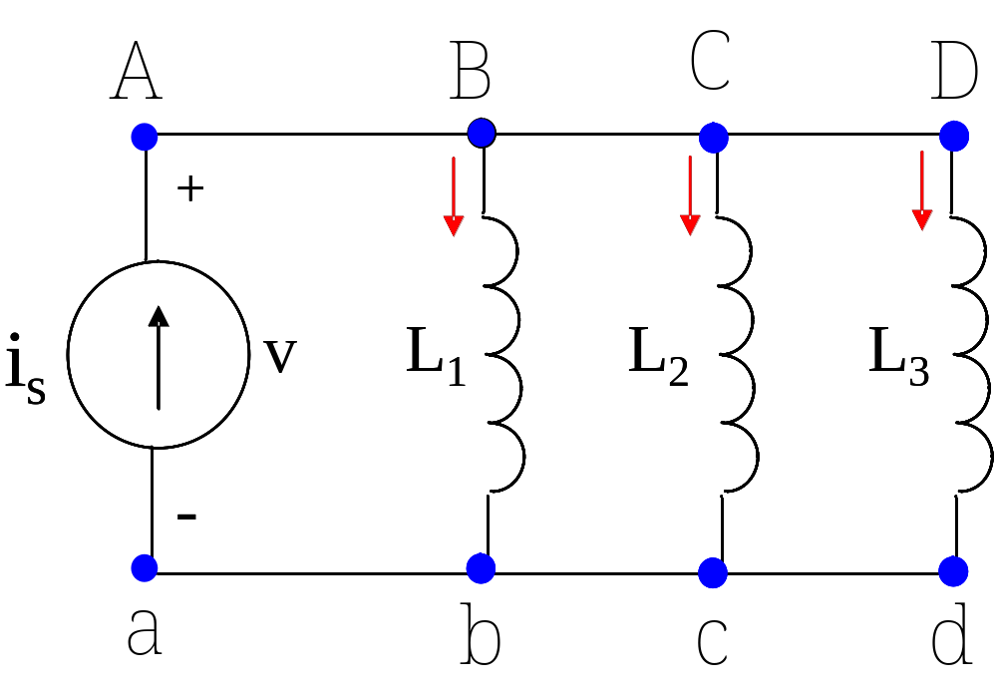
Example
How many branches, nodes, loops & meshes?
4
2
6
3

Slide 14
How many meshes? Branches? Essential and trivial nodes?
Taken from http://www.enee.umd.edu/class/enee204-2.S2000/chapters.htm

Slide 15
The answer is:
6 meshes
6 essential nodes
3 trivial nodes
11 branches
Taken from http://www.enee.umd.edu/class/enee204-2.S2000/chapters.htm

Slide 16
3.2 2b-method for Circuit Analysis
What is the Question?
Two theorems
2b-method

Slide 17
What is the Question?
First, what should we do for circuit analysis?
  Build equations for a given circuit;
  Solve equations to determine currents and voltages for all (or required) circuit elements.
Then, how many independent equations should we have to solve for a given circuit?

Slide 18
There are two unknowns (voltage & current) to be determined for every element;
Generally, for a circuit with b branches, we have 2b unknown variables:
  2b = b (voltages) + b (currents)
Therefore, we have to solve 2b independent equations for a circuit with b branches!

Slide 19
What is the Question now?
How can we get the necessary 2b equations ?
Can a circuit be solved by equations less than 2b ?
If yes, how many at least, and how can we get them?

Slide 20
Theorem 1
For a circuit with n nodes, KCL yields (n-1) independent equations for any (n-1) nodes.

Slide 21
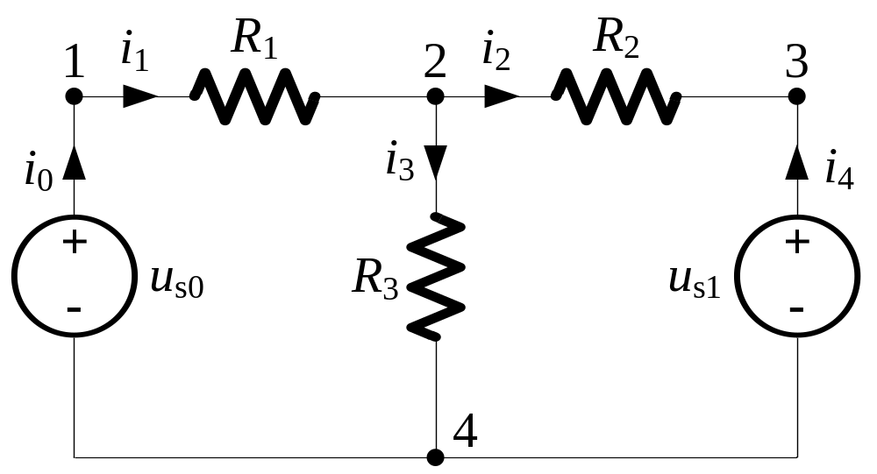
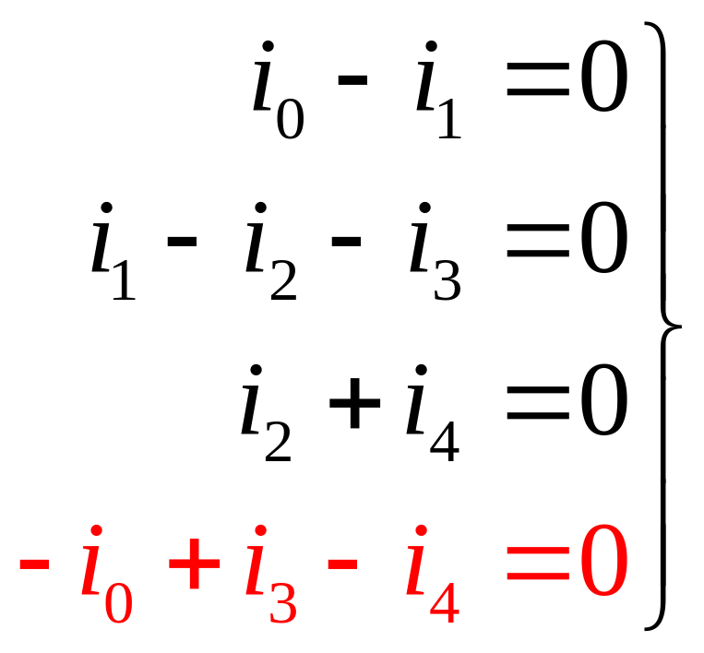
For Example:
Apply KCL to all nodes :
Only 3 equations are independent.

Slide 22
Theorem 2
For a circuit with n nodes and b branches:
  The circuit must have m = b-(n-1) meshes;
  KVL yields m = b-(n-1) independent equations for the m = b-(n-1) meshes.

Slide 23
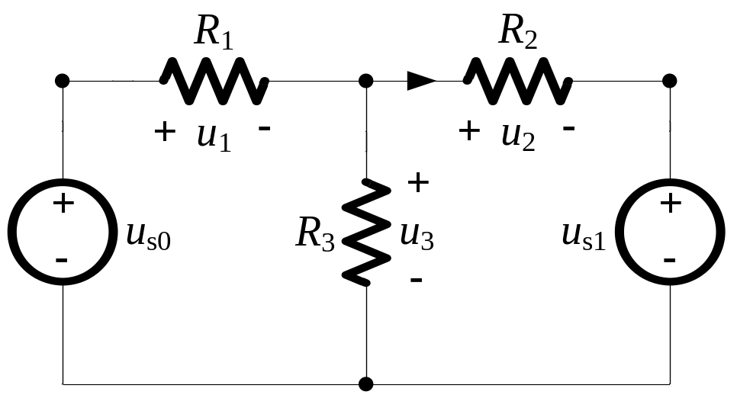

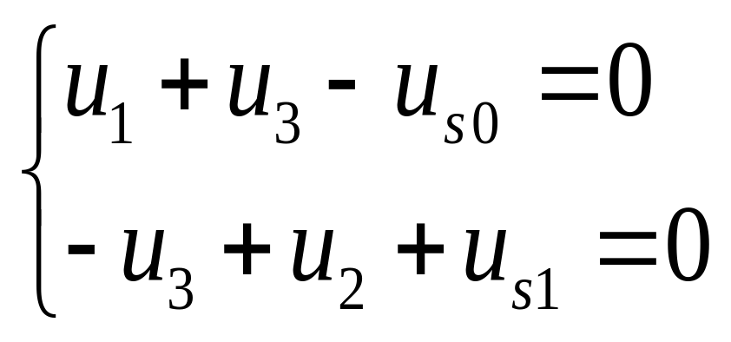
For Example:
n = 4, b = 5
m = b-(n-1) = 2
Ⅰ
Ⅱ
Apply KVL to mesh Ⅰand Ⅱ:

Slide 24
2b -Method
How to get the required 2b independent equations?
  (n-1) KCL equations by (n-1) nodes
  b-(n-1) KVL equations by b-(n-1) meshes
  b VCR equations by b branches by element constraints, eg. Ohm’s Law

Slide 25
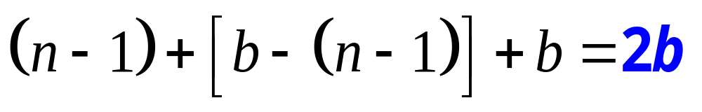
2b -Method
Total number of equations:
(n-1) nodes
(KCL)
m=b-(n-1) meshes
(KVL)
b
branches
(element constraint)

Slide 26
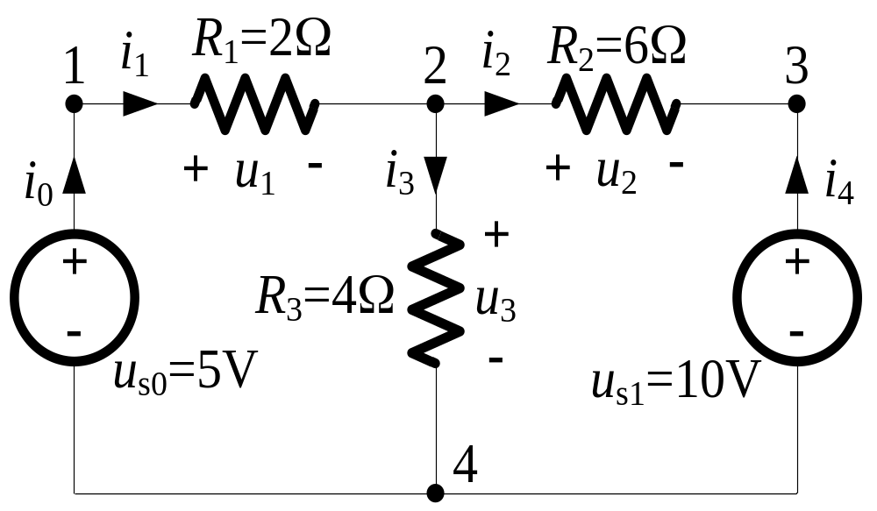
Example
Determine the voltage and current for every branch.

Slide 27
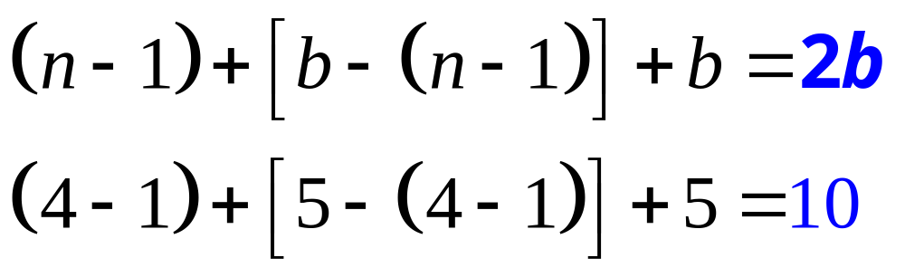
Analysis:
The circuit has 5 branches;
5 voltages and 5 currents to be determined;
Therefore, 10 independent equations to be solved;
How can we obtain the 10 independent equations?

Slide 28
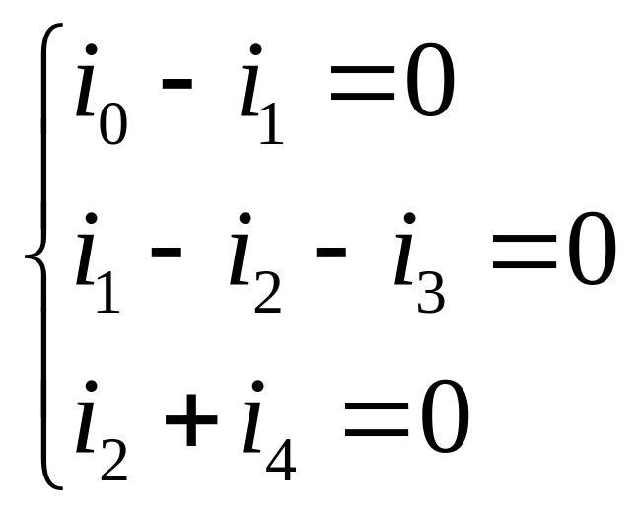
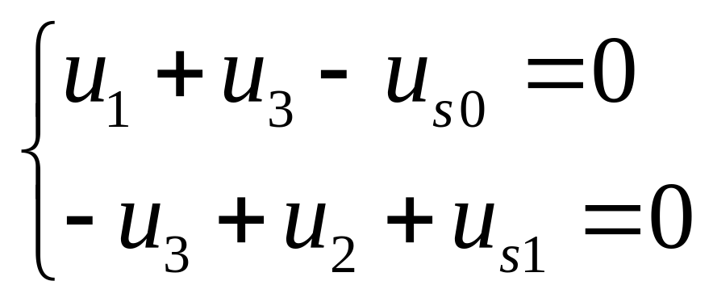
Solution:
Apply KCL to node 1, 2, 3:
m=b-(n-1)=5-(4-1)=2
Apply KVL to mesh Ⅰand Ⅱ:

Slide 29
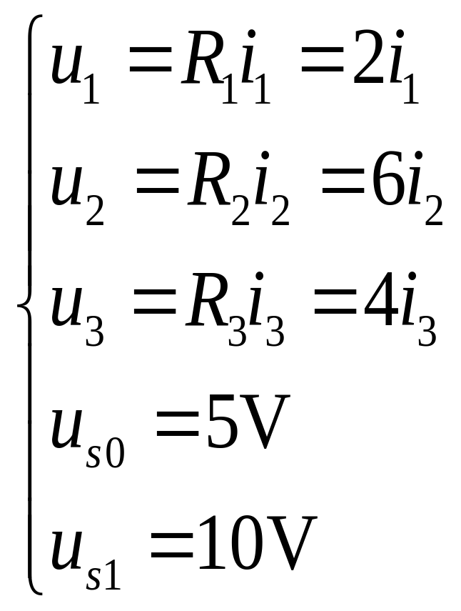
For every branch, we have:

Slide 30
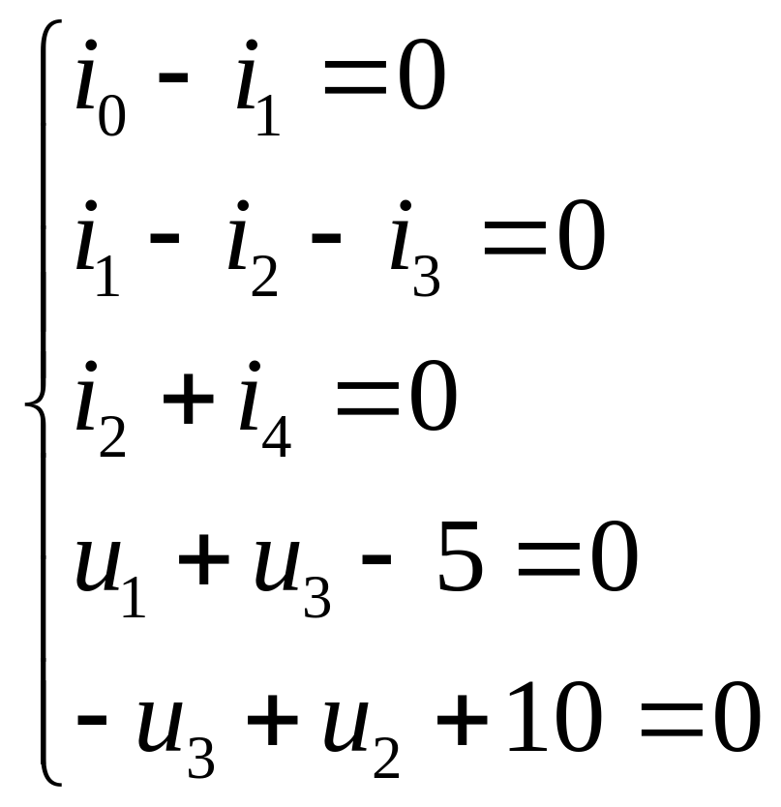
Then we get the required 10 independent eq:

Slide 31
Considering Independent Sources
Assuming the number of independent sources is s:
Unknown variables: s+2(b-s)=(2b-s)
  s unknowns for s independent sources
  2(b-s) unknowns for (b-s) branches

Slide 32
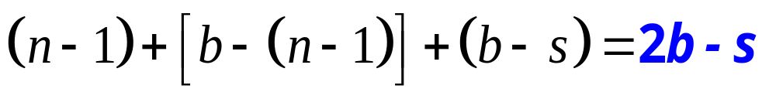
Considering Independent Sources
Total number of equations:
(n-1) nodes
(KCL)
m=b-(n-1) meshes
(KVL)
b-s branches
(element constraint)

Slide 33
What is the Question now?
How can we get the necessary 2b equations ?
Can a circuit be solved by equations less than 2b ?
If yes, how many at least, and how to get them?

Slide 34
Of course Yes.
Node-Voltage Analysis Method
Mesh-Current Analysis Method

Slide 35
3.3 Node-Voltage Analysis
What is node voltage?
Why is node voltage used?
How is node voltage analysis method implemented?

Slide 36
What is Node Voltage?
Node voltage is defined as the voltage rise from the reference node;
Voltages across all branches can be represented by node voltages.

Slide 37
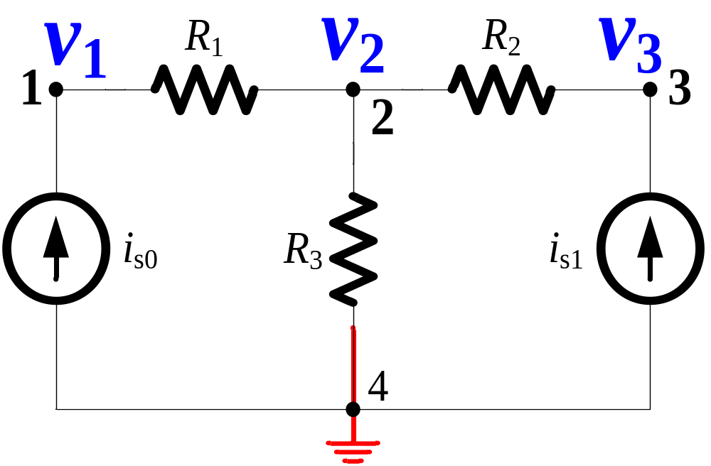
What is Node Voltage?
Node voltage
Reference node

Slide 38
Why Node Voltage Analysis?
The number of node in a circuit is n:
  n-1<b<2b
Use node-voltage as unknowns to solve a given circuit can greatly reduce the number of equations to be solved.

Slide 39
HOW is node voltage analysis method implemented?

Slide 40
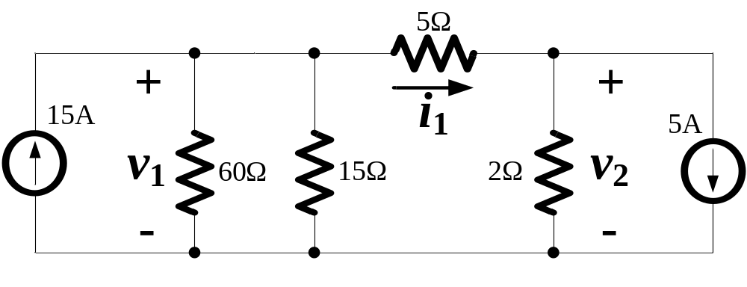
Example
Find v₁, v₂, and i₁.

Slide 41
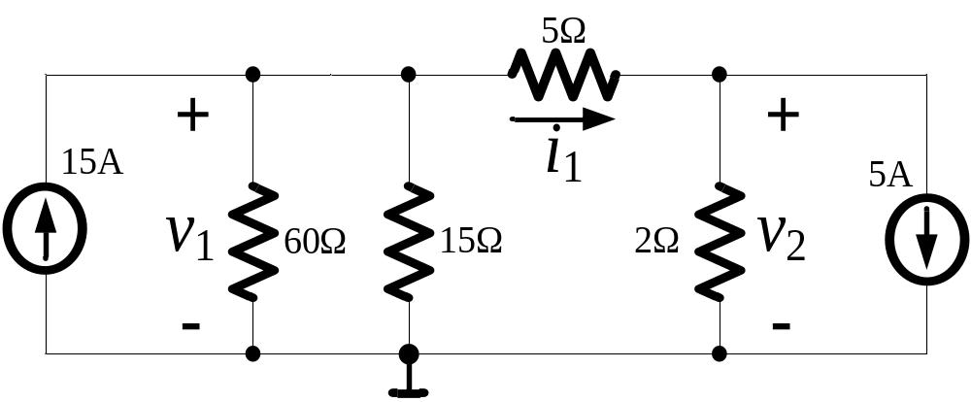
Solution:
Step 1: Select reference node and define node voltages:
u₁
u₂
Reference node

Slide 42
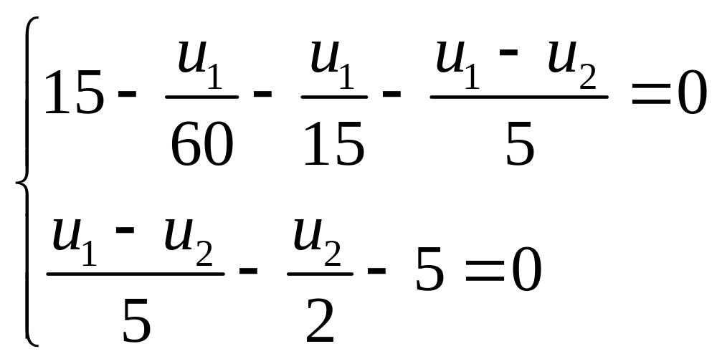
Step 2: Build KCL equations for nodes except the reference node

Slide 43
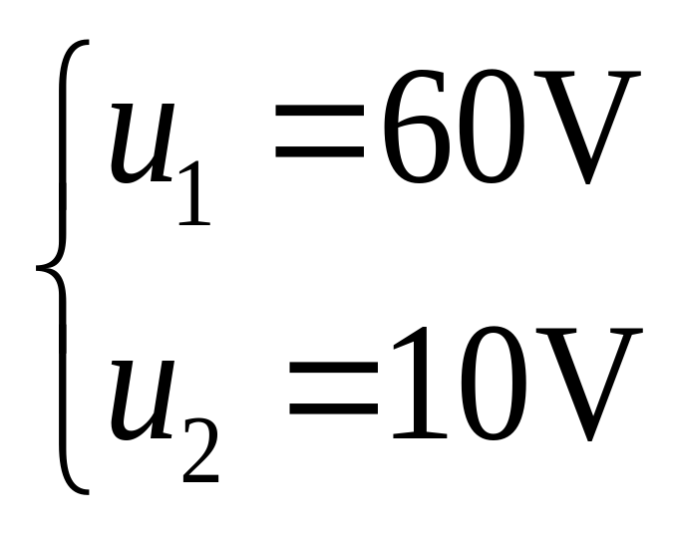
Step 3: Solve equations to get node voltages:

Slide 44
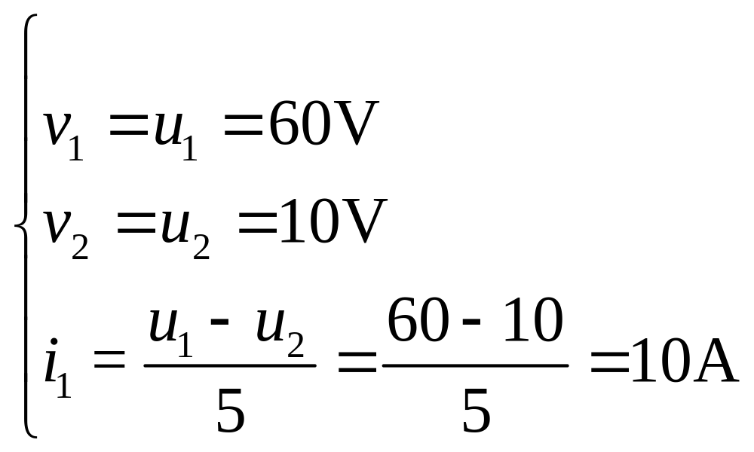
Step 4: Determine required unknown voltages and currents by solved node voltages:

Slide 45
Further, if necessary, other unknown voltages, currents, or powers can also be determined, and the circuit is completely solved;
If necessary, answers can be checked by power balance.

Slide 46
Steps of Node-Voltage Method
Select one of the nodes as the reference node, and define node voltages for other nodes;
Build KCL equations for nodes except the reference node;
Solve equations for the node voltages;
Determine required voltages, currents or powers by node voltages.

Slide 47
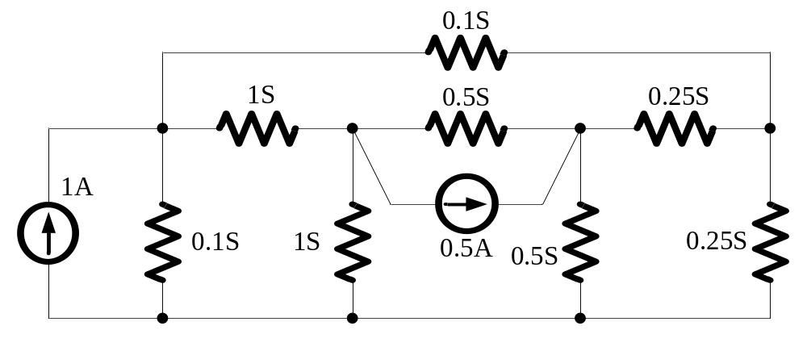
Example
Find the power dissipated by all resistors in the circuit.

Slide 48
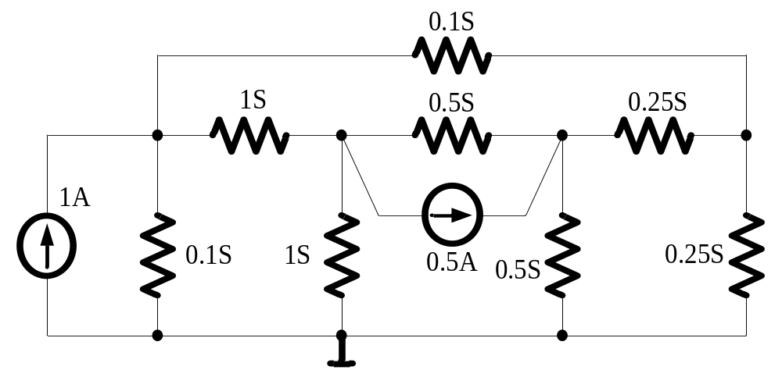
Solution:
Select the reference node and define node voltages:
v₁
v₂
v₃
v₄

Slide 49
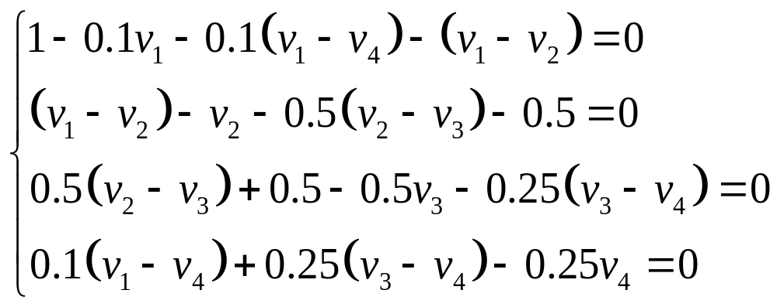
Build KCL equations for nodes except the reference node:

Slide 50
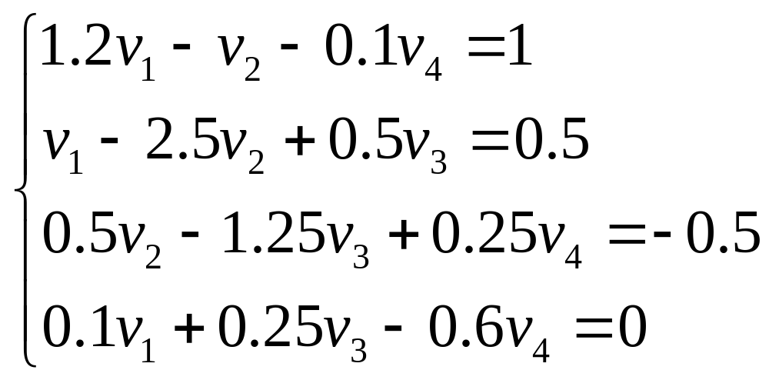
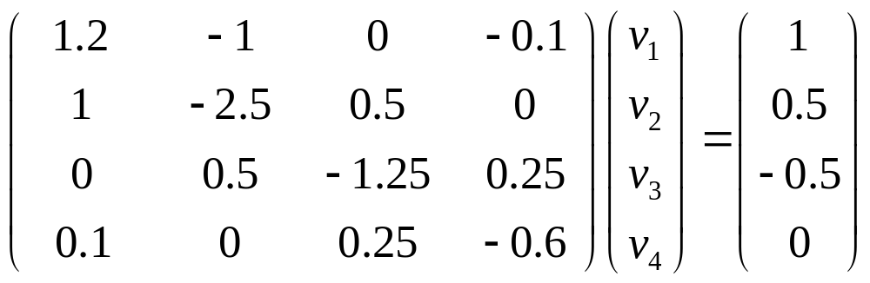

Slide 51
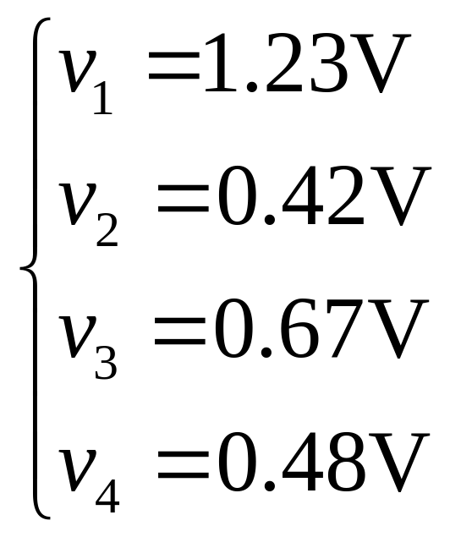
Solve equations for node voltages by Cramer’s rule:
Then, calculate power dissipated by all resistors…

Slide 52
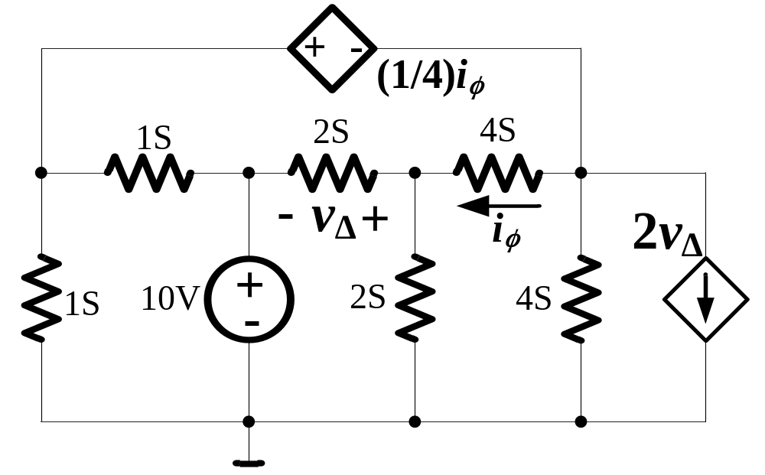
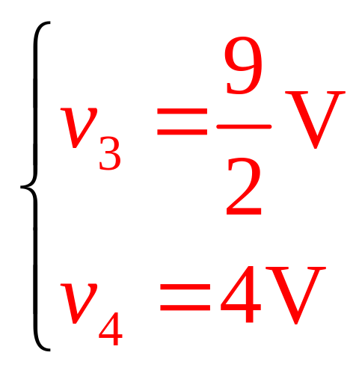
Example with Dependent Source
v₁
v₂
v₃
v₄
Use node-voltage method to find the value of v₃ and v₄.

Slide 53
Concept of Super Node
v₁
v₂
v₃
v₄

Slide 54
3.4 Mesh-Current Analysis Method
What is mesh current?
Why is mesh current used?
How is mesh current analysis method implemented?

Slide 55
What is Mesh Current?
Mesh current is introduced just as an imaginary quantity;
Mesh current flows around a mesh;
All branch currents do not change for introducing mesh currents
All branch currents can be represented by mesh currents.

Slide 56
What is Mesh Current?
Branch currents:
i_{a}
i_{c}
i_{b}
i_{c} = i_{a} - i_{b}
Mesh currents:
i_{c} = i_{m1} – i_{m2}
i_{m1}
i_{m2}
i_{a} = i_{m1}
i_{b} = i_{m2}

Slide 57
Why Mesh Current analysis?
The number of mesh in a circuit:
  m=b-(n-1)<b<2b
Use mesh-current as unknowns to solve a circuit can greatly reduce the number of equations to be solved.

Slide 58
HOW is mesh current analysis method implemented?

Slide 59
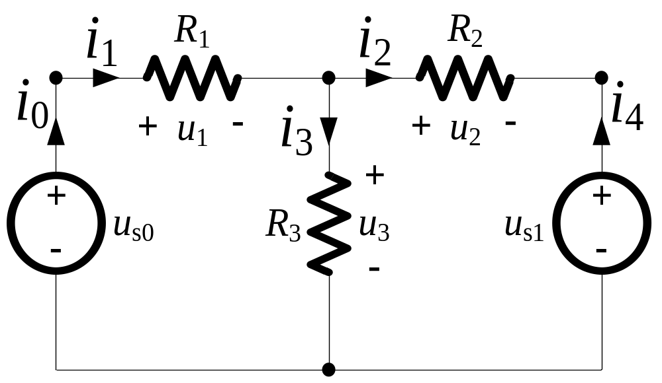
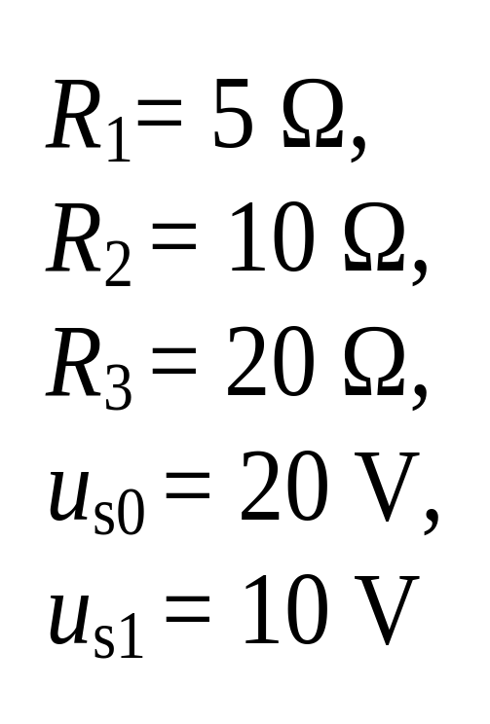
Example:
Determine the currents of every branch.

Slide 60
Solution:
Step 1: Select mesh current i_{a} and i_{b}
i_{a}
i_{b}

Slide 61
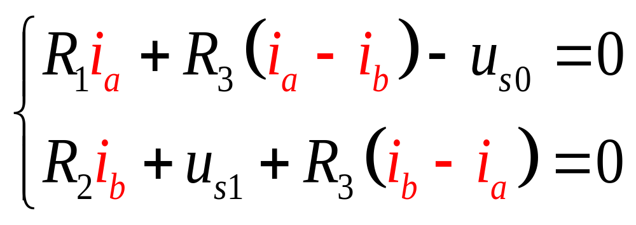
Step 2: Build KVL equations for all meshes

Slide 62
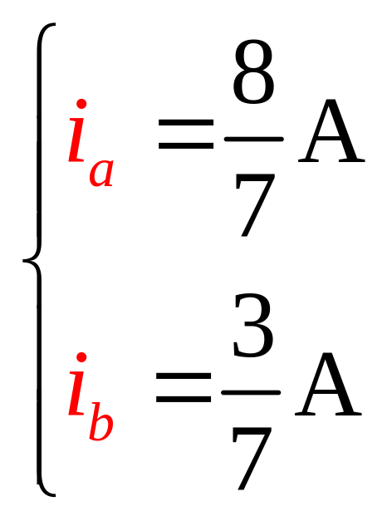
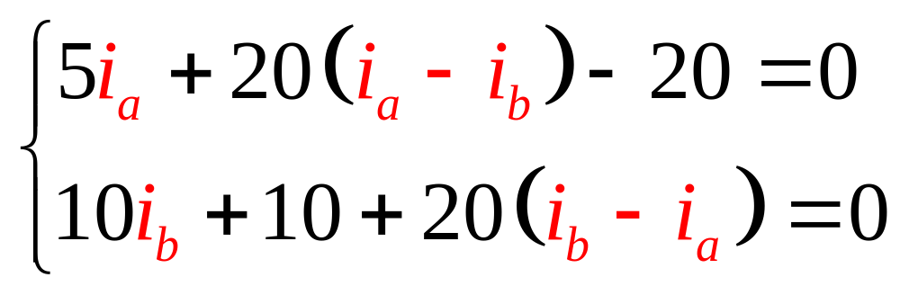
Step 3: Solve equations to get mesh current i_{a} and i_{b}

Slide 63
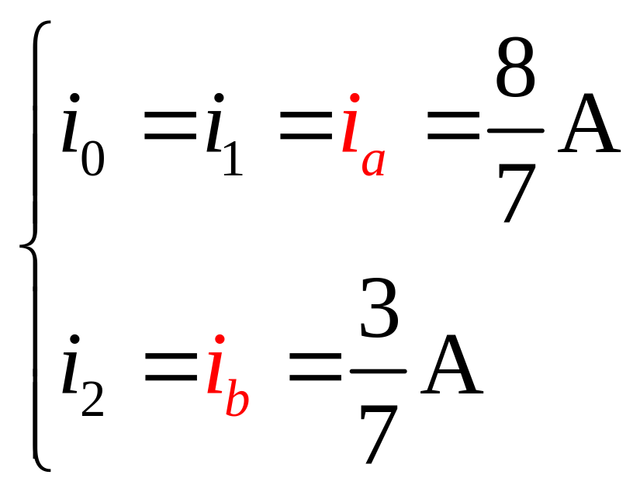
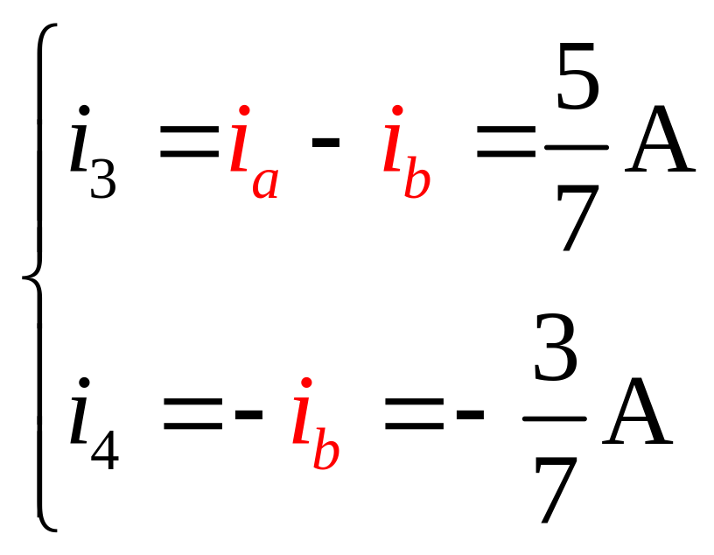
Step 4: Determine required currents by mesh current i_{a} and i_{b}.

Slide 64
Further, if necessary, other unknown voltages and currents can also be determined, and the circuit is completely solved;
If necessary, answers can be checked by power balance.

Slide 65
Steps of Mesh-Current Method
Assume mesh current and its reference direction (clockwise) for every mesh;
Build KVL equations for every mesh;
Solve equations for mesh currents;
Determine required unknown currents and voltages by mesh currents.

Slide 66
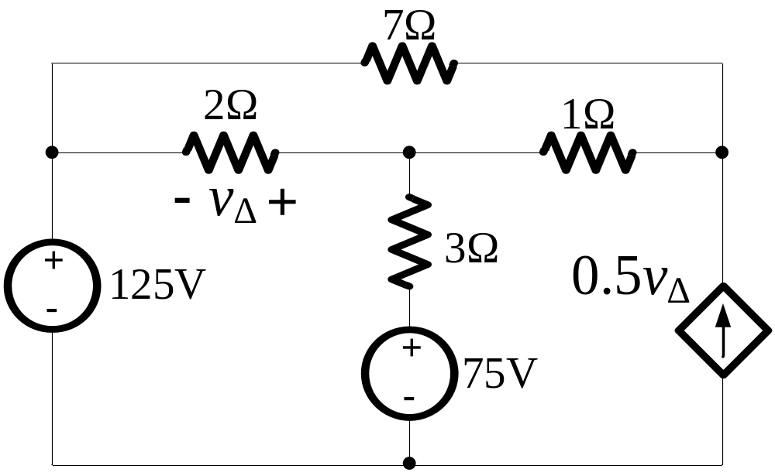
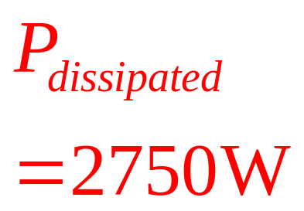
Example with Dependent Source
Use mesh-current method to find the total power developed in the circuit.

Slide 67
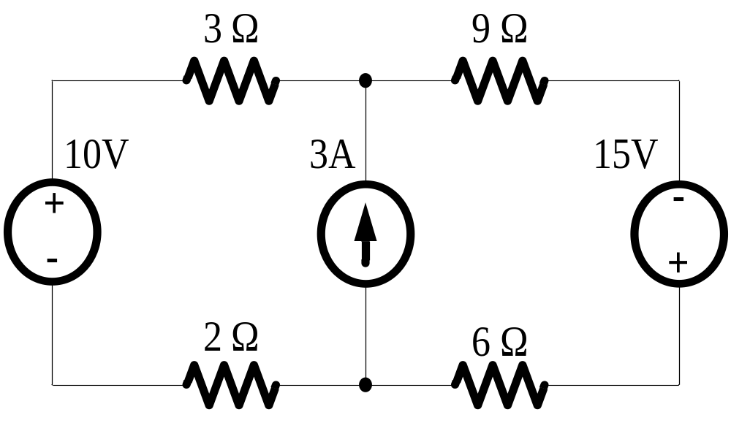
Example of Super-Mesh
Use mesh-current method to find the total power dissipated in the circuit.

Slide 68
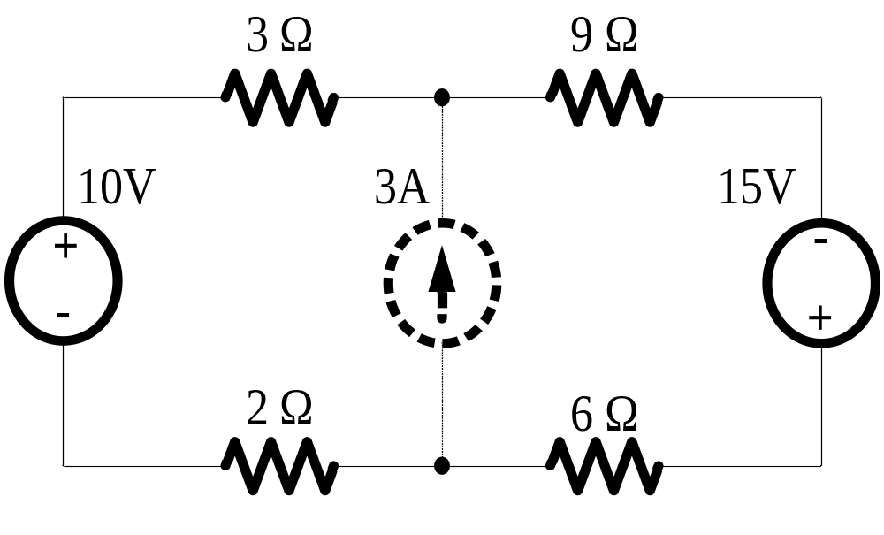

Concept of Super-Mesh
i_{a}
i_{b}

Slide 69
Nodal method VS Mesh method
Mesh analysis only applies to planar circuits;
Node-voltage method results in direct calculation of voltage; whereas mesh-current analysis provides currents;
Mesh analysis results in m=b-(n-1) equations; and nodal analysis results in (n-1) equations.

Slide 70
3.5 Thévenin and Norton Equivalents
Thévenin Equivalent Circuit
Norton Equivalent Circuit

Slide 71
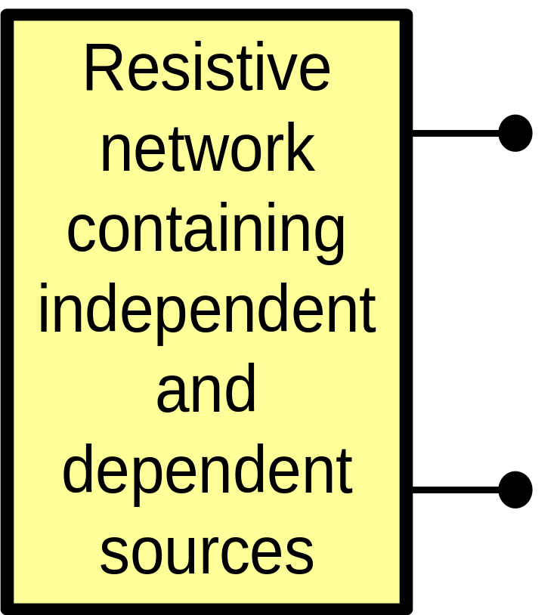
Thévenin and Norton Equivalents
At times, we only have interest in the behavior at the two terminals;
Thévenin and Norton Equivalents are circuit simplification techniques that focus on terminal behavior.
a
b

Slide 72
Thévenin Equivalent Circuit
A network with two terminals can be equivalent to an independent voltage source v_{TH} in series with a resistor R_{TH};
v_{TH} is the open-circuit voltage when the two terminals are disconnected;
R_{TH} is the equivalent resistance of the two-terminal network when all independent sources in it are zeroed out (killed).

Slide 73
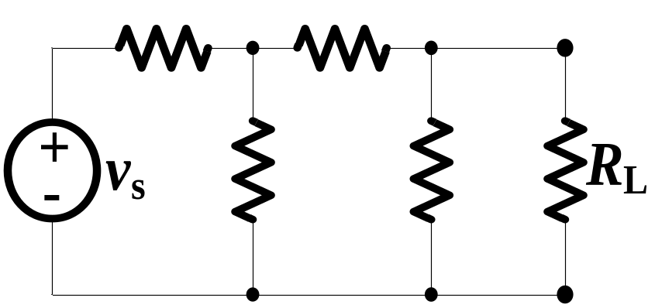
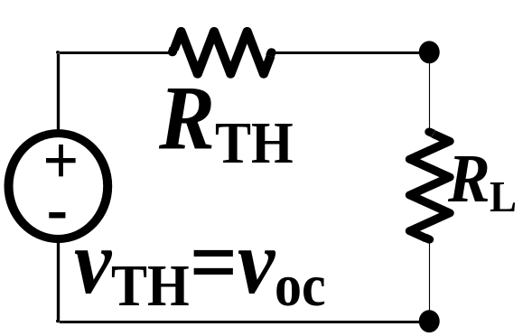
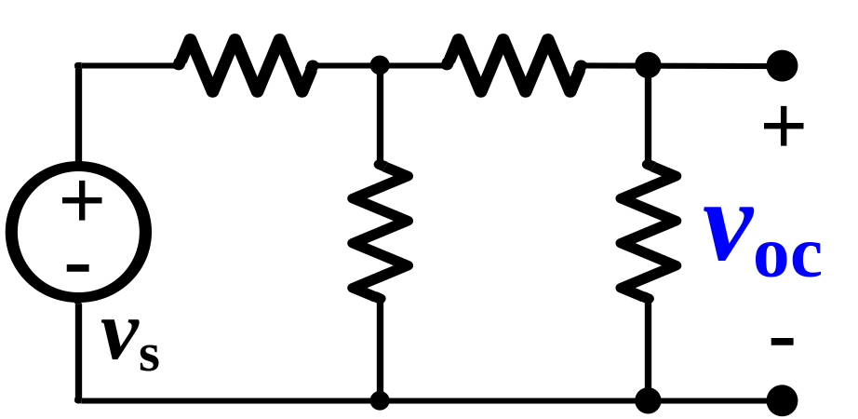
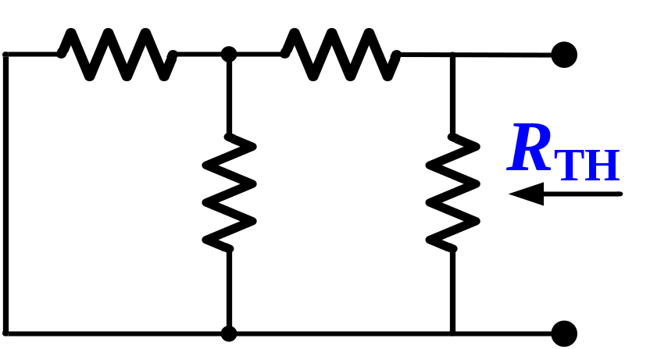
Thévenin Equivalent Circuit
a
a
b
b

Slide 74
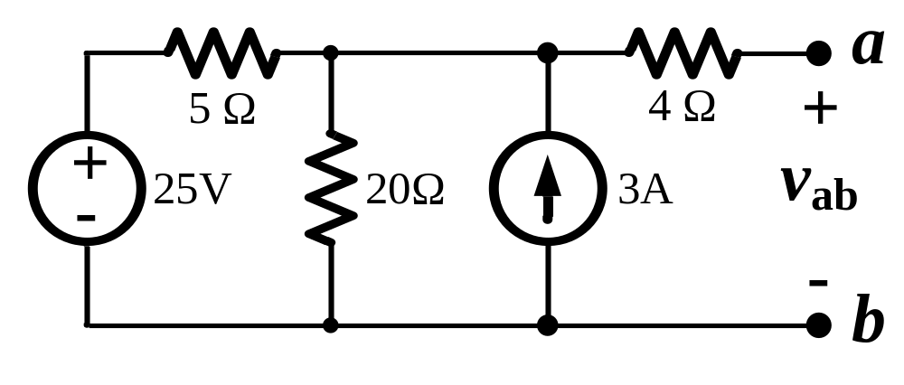
Example
Find the Thévenin equivalent of the circuit between terminals a and b.

Slide 75
Solution:
Find the open circuit voltage between two terminals a and b:
v_{oc}

Slide 76
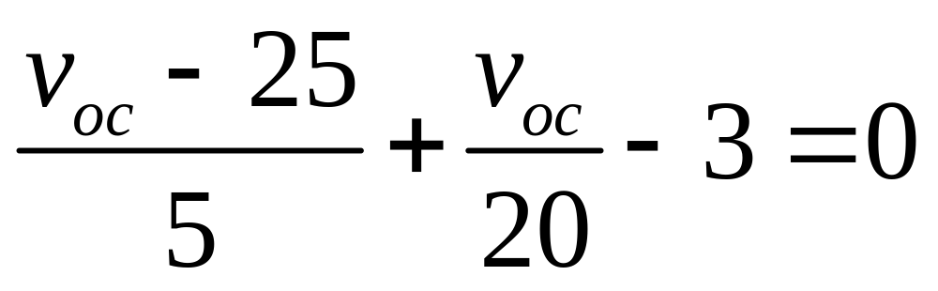
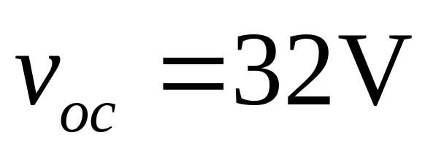
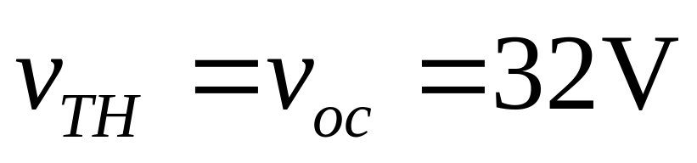
By node-voltage analysis method, we have:

Slide 77
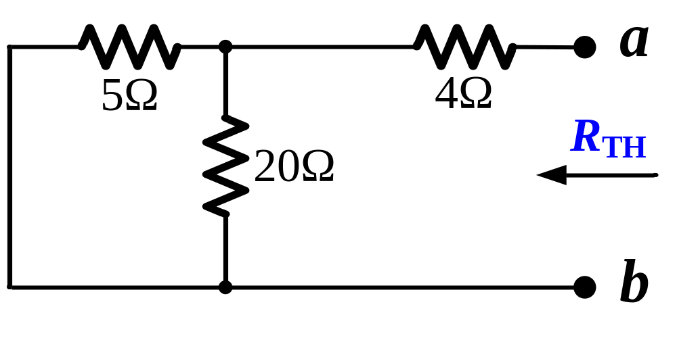

Find the Thévenin equivalent resistance between two terminals a and b:

Slide 78
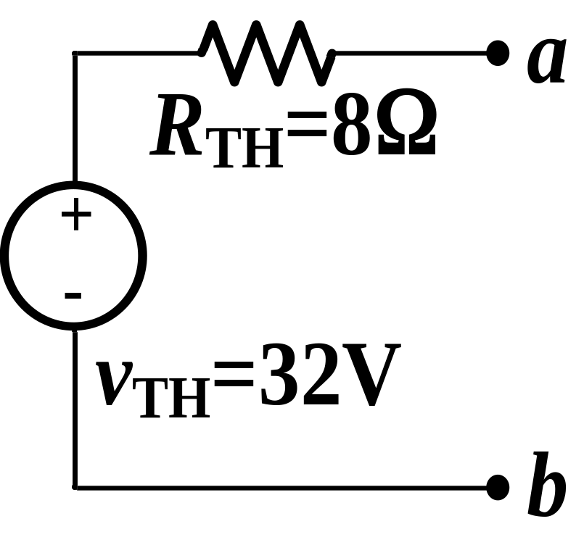
Then, the Thévenin equivalent of the circuit between terminals a and b is:

Slide 79
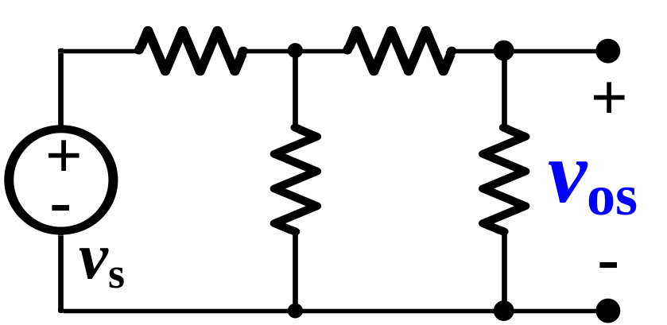

Thévenin Equivalent Circuit
a
b
Open-Circuit Voltage
Short-Circuit Current

Slide 80


Thévenin Equivalent Circuit
a
a
b
b

Slide 81
Example
Find the Thévenin equivalent of the circuit between terminals a and b.

Slide 82
Solution:
Find the open circuit voltage between a and b:
v_{oc}

Slide 83

Find the short circuit current from a to b:
v

Slide 84



By node-voltage method, we have:

Slide 85

Then, we have:

Slide 86

Example
Find the Thévenin equivalent with respect to the terminals of a and b.

Slide 87
Solution:
Find the open circuit voltage:

Slide 88


By node-voltage method, we have:

Slide 89

Find short circuit current from a to b:

Slide 90



By node-voltage method, we have:

Slide 91



Slide 92

Example
Find the Thévenin equivalent with respect to the terminals a, b.

Slide 93

Solution:
Since the circuit contains no independent sources,

Slide 94

Apply a test voltage source to terminal a and b:
v

Slide 95


By node voltage method, we have:

Slide 96



Slide 97
Norton Equivalent Circuit
A network with two terminals can be equivalent to an independent current source i_{sc} in parallel with a resistor R_{N};
i_{sc} is the short-circuit current when the two terminals are directly connected;
R_{N} is the equivalent resistance of the two-terminal network when all independent sources in it are zeroed out (killed).

Slide 98


Norton Equivalent Circuit
a
a
b
b

Slide 99


Norton Equivalent Circuit
a
a
b
b
Norton equivalent can be derived from Thévenin equivalent by source transformation; and vice versa.

Slide 100
Thévenin and Norton Equivalents
Both Thévenin and Norton circuits provide an equivalent for a 2-terminal network, and the “load” network (R_{L}) would not “know” if it was “seeing” the equivalent;
Thévenin equivalent can be derived from Norton equivalent by source transformation; and vice versa.

Slide 101

3.6 Maximum Power Transfer
Problem:
  To determine the value of the load R_{L} that permits maximum power delivered to R_{L}.
a
b

Slide 102


a
a
b
b
Power delivered to R_{L}:

Slide 103



The derivative of power p with respect to R_{L}:
Maximum power transfer occurs
Let
, we get:

Slide 104

Maximum Power Transfer
Condition of maximum power transfer:
The maximum power delivered to R_{L} is:

Slide 105
Key Notes of Chapter 3
Node-voltage analysis method
Mesh-current analysis method
Thévenin and Norton Equivalent
Maximum power transfer

